Slide 1


CODE FURY CONTEST
Automated Meeting Room Booking System
TEAM - BYTE BRIGADE

Slide 2

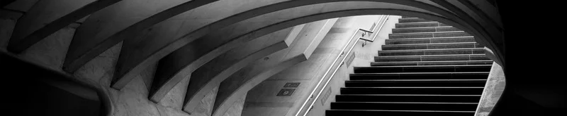
Our Team
Vishnu Vardhan - Team Lead
Navya
Smiti
Neha
Surya Sravan
G V S Yaswant
Mohammad Tanveer

Slide 3
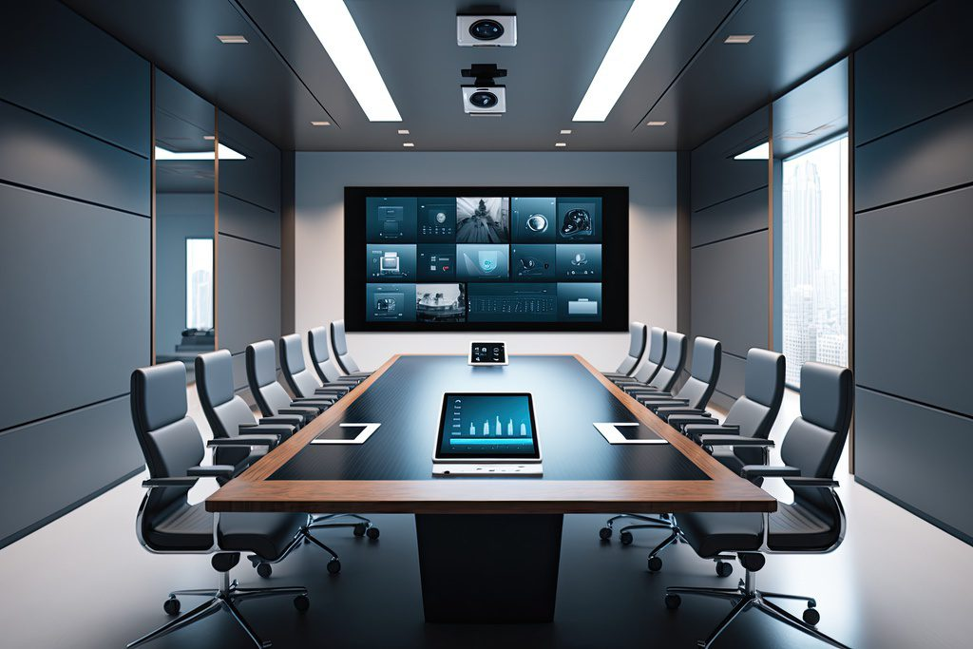
About
The Automated Meeting Room Booking System is designed to streamline the process of reserving meeting spaces within an organization. This aims to enhance efficiency in managing meeting room availability, facilitating seamless bookings, and ensuring effective utilization of resources.

Slide 4
The meeting room booking system ensures that employees can efficiently search for and book rooms based on specific needs, such as seating capacity and available amenities.
This system categorizes users into three distinct roles: Admin, Manager, and Member.
Admin: Responsible for creating, configuring, and managing meeting rooms.
Manager: Can book rooms according to specific requirements like seating capacity and available amenities (e.g., projector, conference call facility, whiteboard).
Member: Has view-only access to scheduled meetings but cannot book rooms.
Introduction

Slide 5







# 1
User Login and Role Management
How the System Works
# 2
Room Creation and Configuration
# 3
Credit Allocation

Slide 6
# 4
Room Booking Process
How the System Works
# 5
Real-Time Schedule Display
# 6
Automatic Credit Reset

Slide 7
1.User Login and Role Management
Users (Admin, Manager, Member) log in based on their role.
Role-based access controls are enforced:
Admins manage rooms and users.
Managers can search and book rooms.
Members can only view meeting schedules.

Slide 8
2.Room Creation and Configuration
The Admin is responsible for setting up meeting rooms in the system. When creating a room, the Admin specifies:
Seating Capacity: Determines the base cost in credits (e.g., smaller rooms cost fewer credits).
Amenities: The Admin can configure various facilities like:
Projector
WiFi Connection
Conference Call Facility
Each amenity has a specific credit cost, which contributes to the overall per-hour booking rate. For instance:
Projector: 5 credits per hour
WiFi: 10 credits per hour
The total booking cost is dynamically calculated based on the selected amenities and seating capacity.

Slide 9
3.Credit Allocation
The system uses a credit-based model to regulate bookings.
Managers receive 2000 credits every Monday morning, allowing them to book rooms throughout the week.
These credits are automatically refreshed at 6 AM each Monday by a background task.
Members do not receive credits and therefore cannot make any room bookings, restricting their access to only viewing schedules.

Slide 10
4.Room Booking Process
Managers begin by searching for a room based on their requirements:
Filters: Include seating capacity, amenities, and availability.
Once a suitable room is found, the Manager selects the room and the system checks:
Credit Availability: The Manager must have enough credits to cover the booking cost.
If sufficient credits are available:
The room is booked, and credits are deducted based on the calculated cost.
The system automatically updates the room status as "Booked" and adds the meeting to the schedule.
If credits are insufficient, the booking is denied.

Slide 11
5.Real-Time Schedule Display
The system maintains an up-to-date schedule view that is accessible to all users.
This schedule includes:
Room Availability: Displays whether a room is booked or free.
Meeting Details: Shows information like the meeting time, organizer, and room number.
The schedule allows users (especially Members) to plan around existing bookings and ensures rooms are used efficiently.

Slide 12
6.Automatic Credit Reset
At 6 AM every Monday, a background process runs to reset all Manager credits back to 2000.
This ensures that Managers start each week with a full credit balance, regardless of the bookings made in the previous week.
The automated reset helps prevent long-term credit depletion and allows consistent booking opportunities.

Slide 13
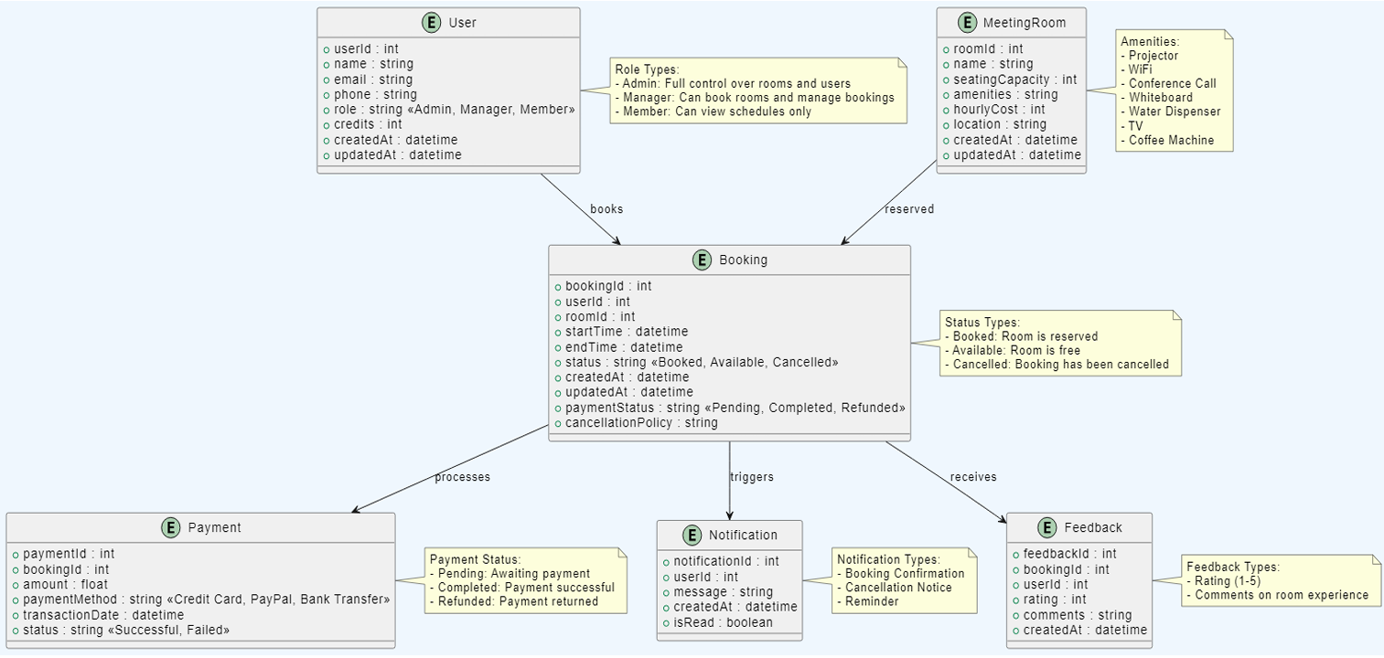
ER Diagram

Slide 14
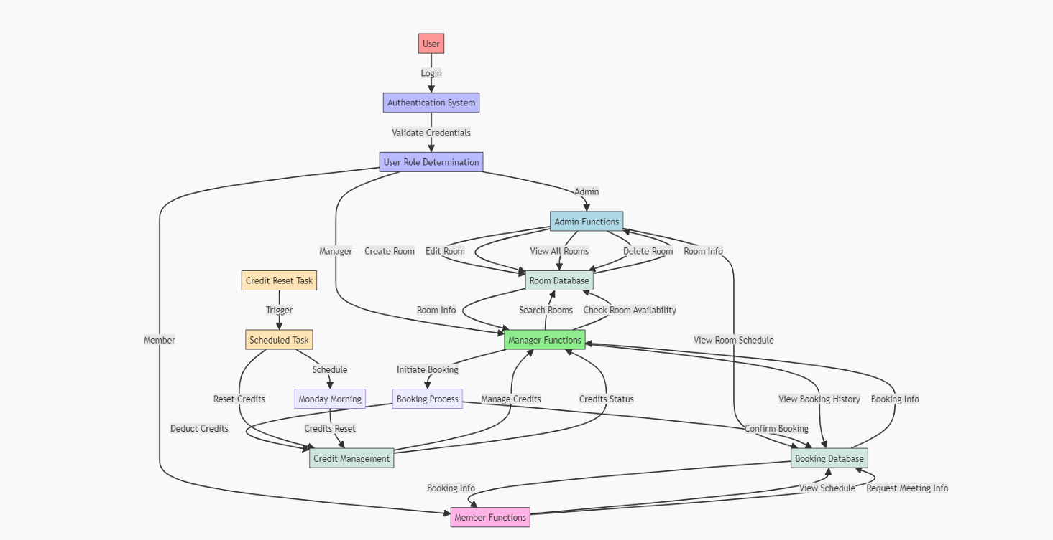
Data Flow Diagram

Slide 15
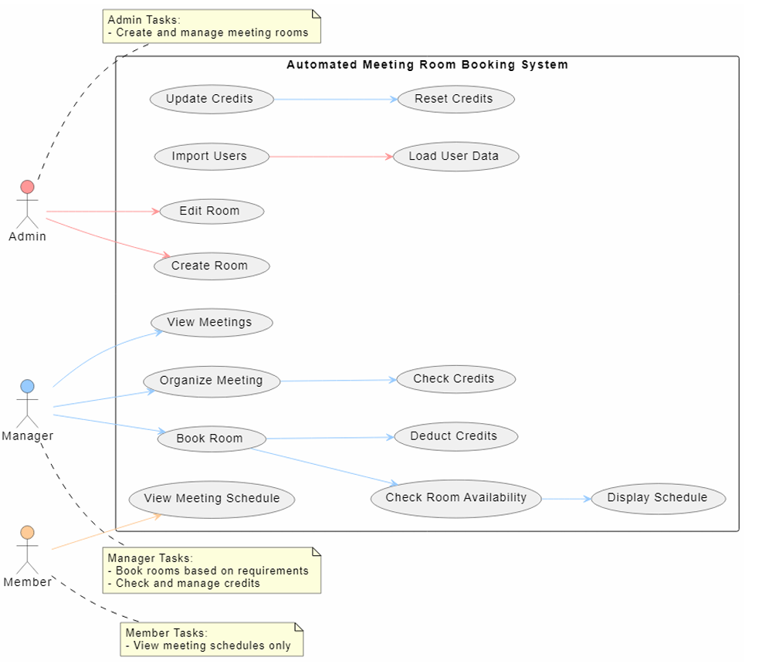
Use Case
Diagram

Slide 16
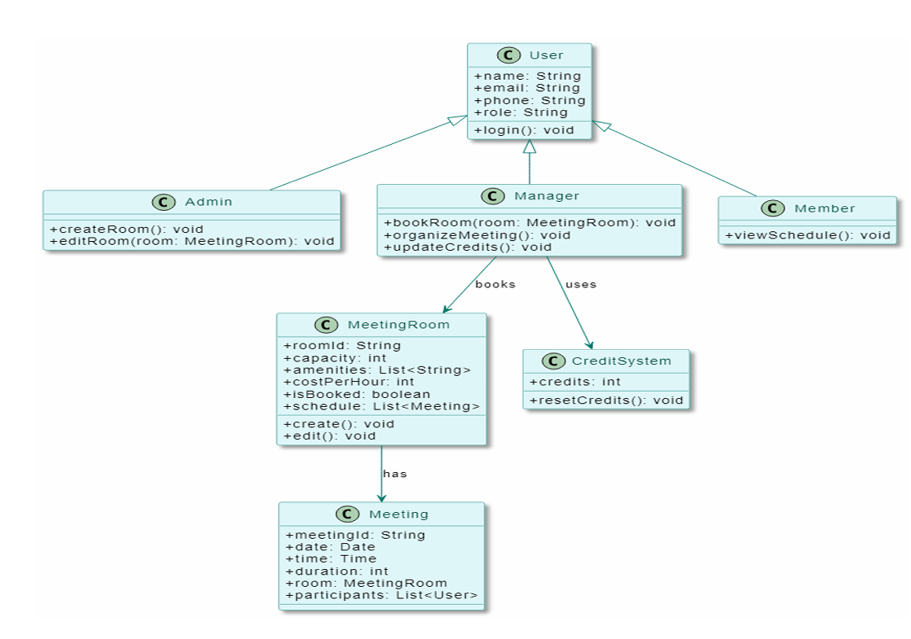
Class
Diagram

Slide 17
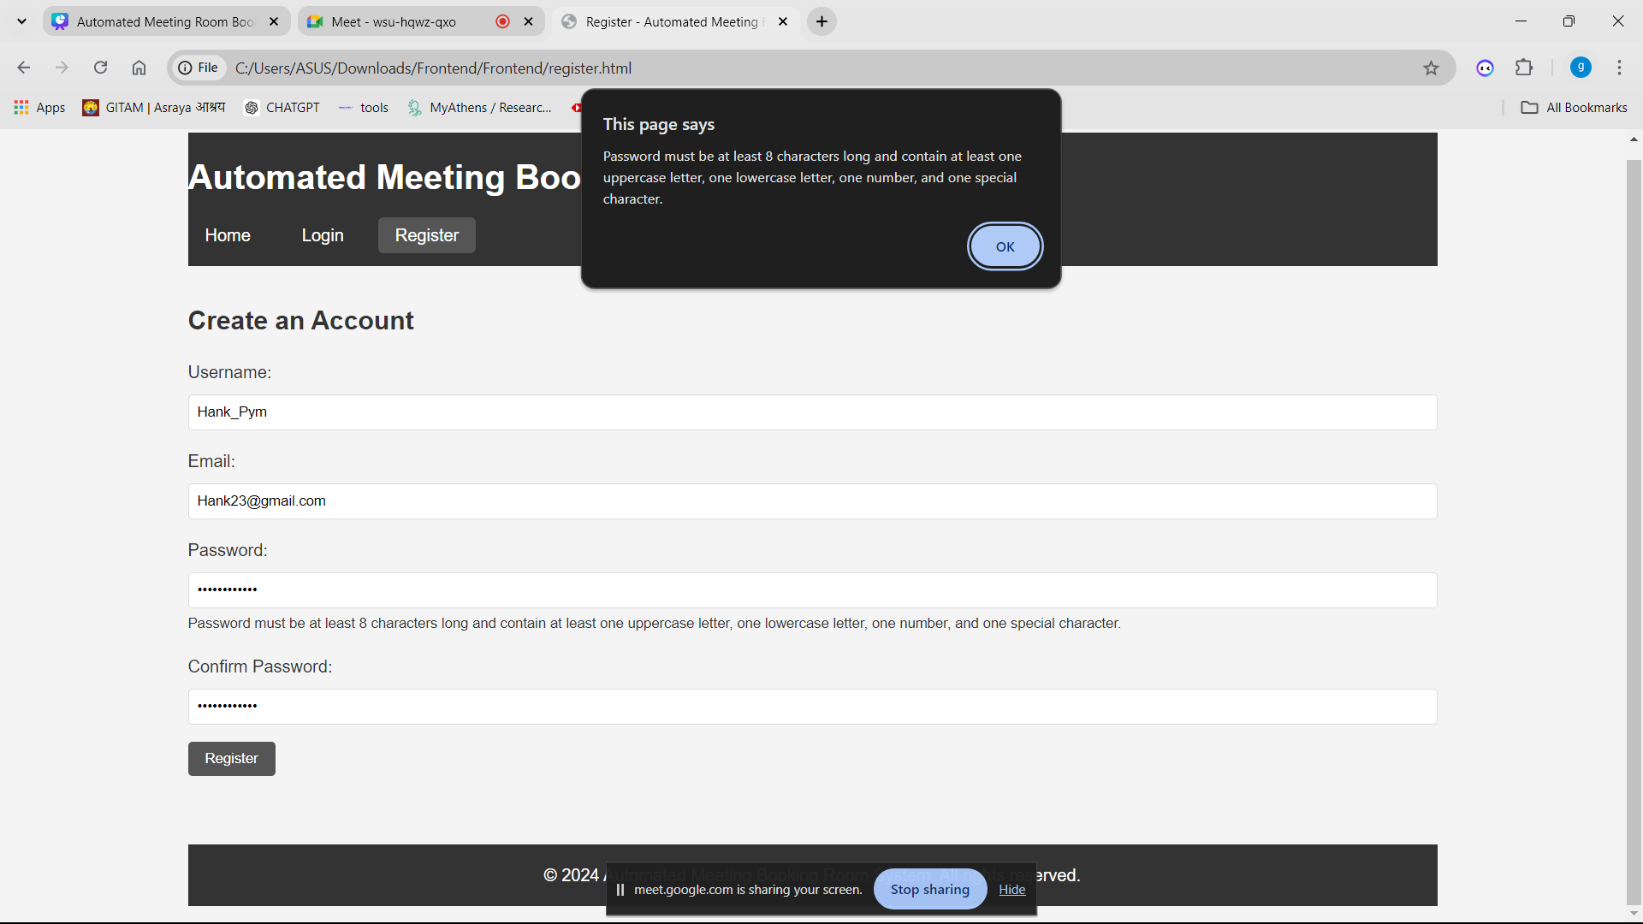

Slide 18
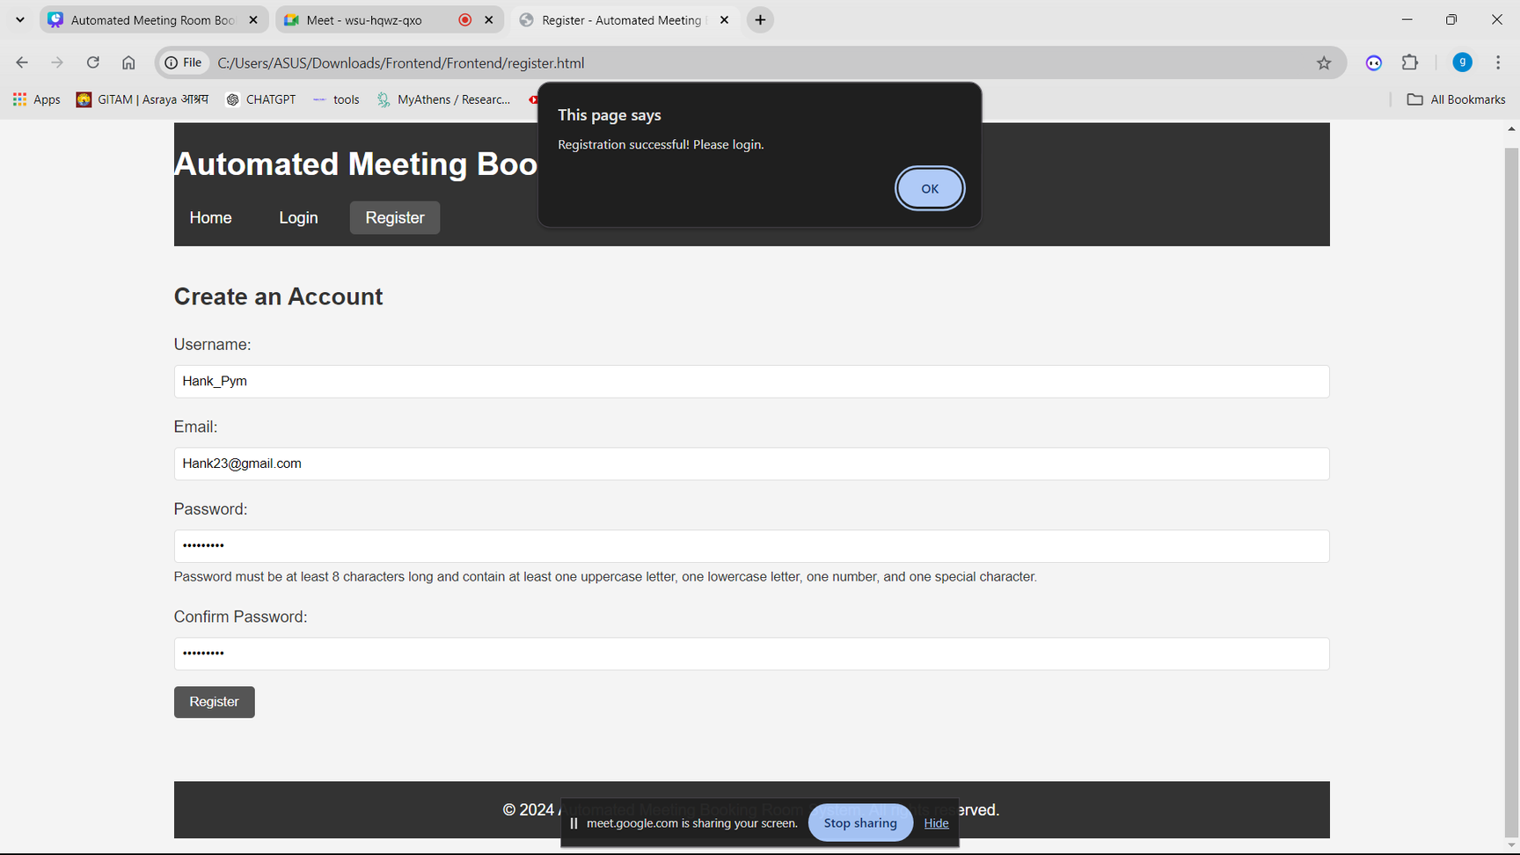

Slide 19
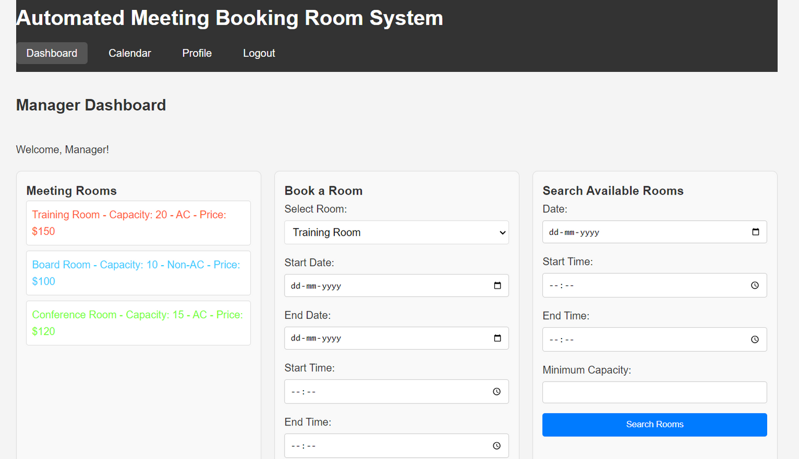

Slide 20
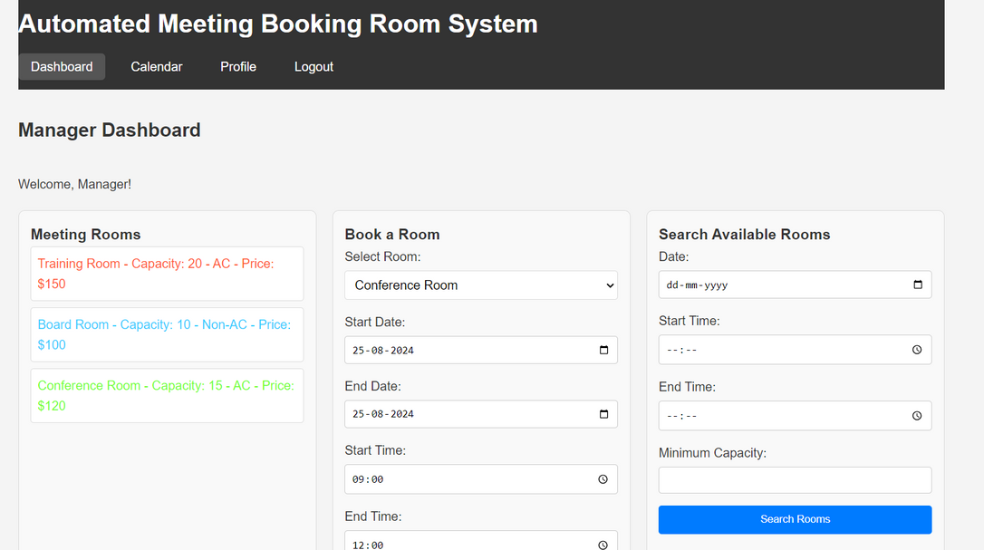
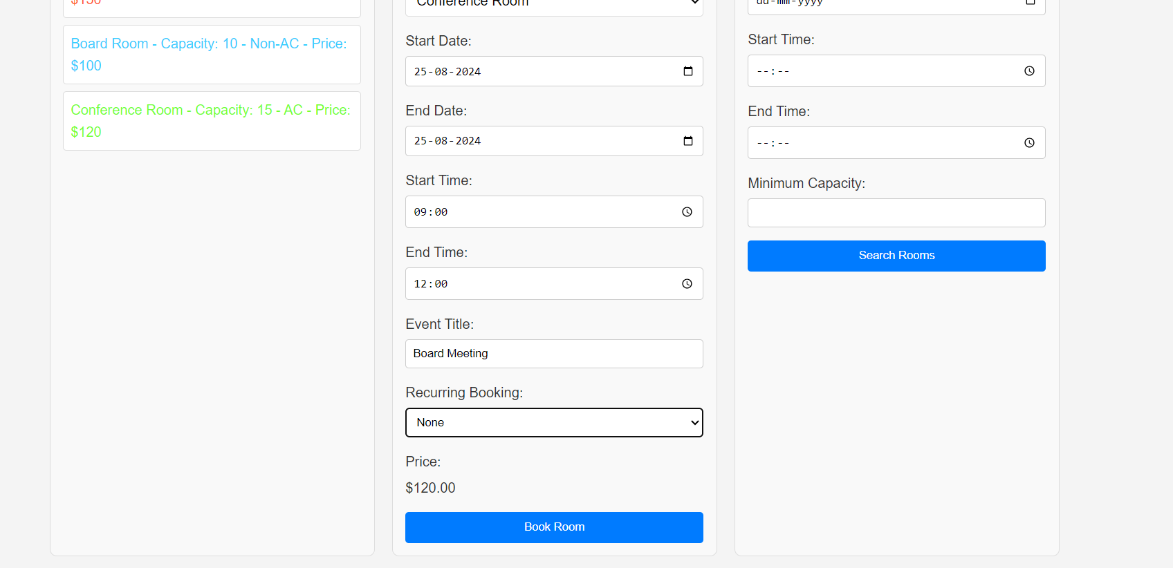

Slide 21
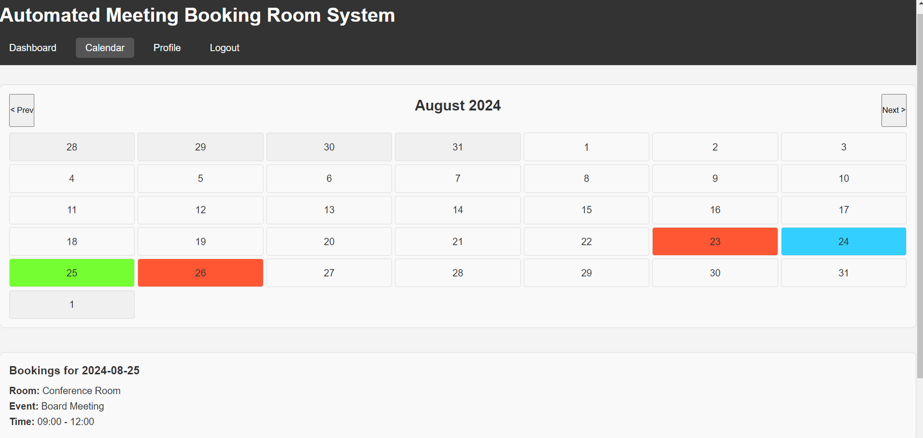

Slide 22
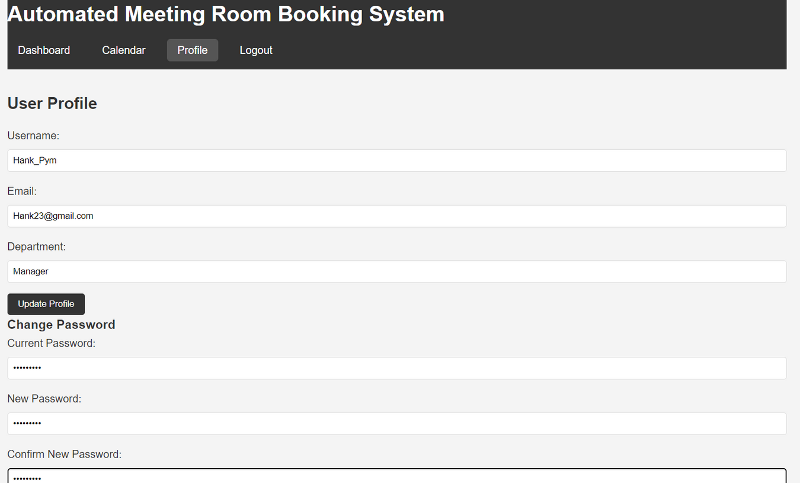

Slide 23
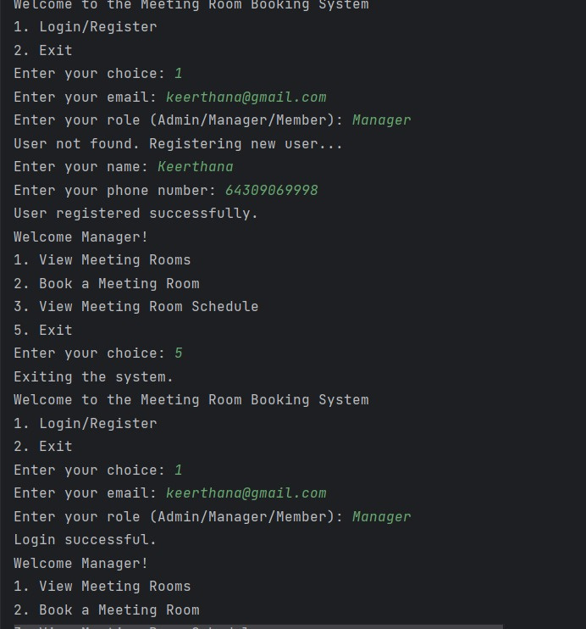

Slide 24
